Slide 1
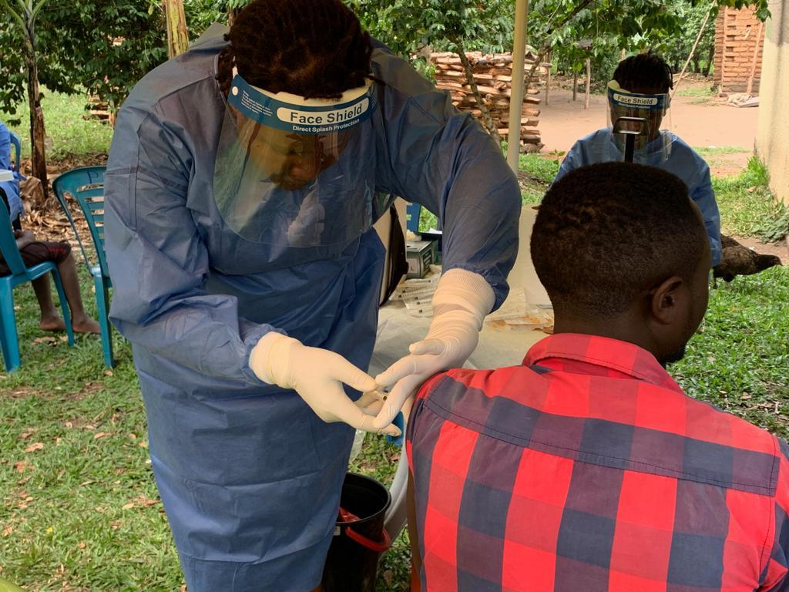


Accessing Ebola vaccines: Emergencies and ICG applications

Slide 2

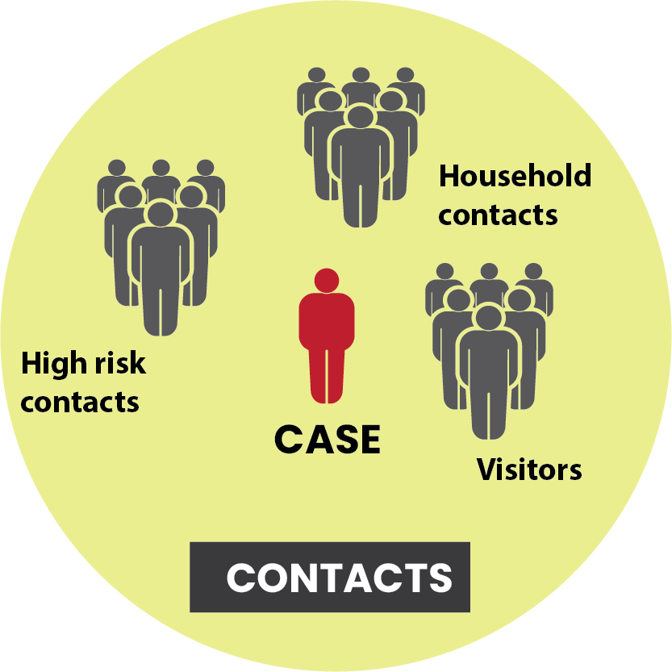

Countries can access Ebola vaccine through two mechanisms
Preventative Ebola vaccination
Gavi is offering financial support for implementation of preventive vaccination
Either PQ’d vaccine can be used for preventive vaccination of at-risk populations
Ebola vaccine coordination team (EVCT) formed in 2023 to develop technical guidance and support countries for preventive vaccine use.
Gavi application to access to vaccine and Operational costs (IRC)
Outbreak response
International coordinating group on vaccine provision (ICG) manages a stockpile of emergency vaccine supplies for outbreak response since 2021
500,000 doses of rVSV-EBOV (Ervebo) available
As Ebola outbreaks are relatively rare and unpredictable in nature, vaccine is reserved for outbreak response to protect people at the highest risk of contracting Ebola
Rolling stockpile, replenished regularly
Note: In 2024, only rVSV-ZEBOV (Ervebo) is available
Notes:
Countries can access Ebola vaccine through two mechanism. The first is through
the Preventive Ebola vaccination funding window that Gavi mentioned earlier today. Either PQ vaccine can be requested for preventive vaccination of at-risk populations. Additionally, to support countries in the rollout, an Ebola vaccine coordination team, with membership from multiple partners was formed in 2023 to develop technical guidance and provide technical support and create and support a monitoring evaluation and learning agenda.
The second option is g
the International coordinating group on vaccine provision, which manages emergency vaccine supplies for outbreak response. In the event of an outbreak, a country would request doses here. There is a rolling 500,000 dose stockpile currently available.

Slide 3
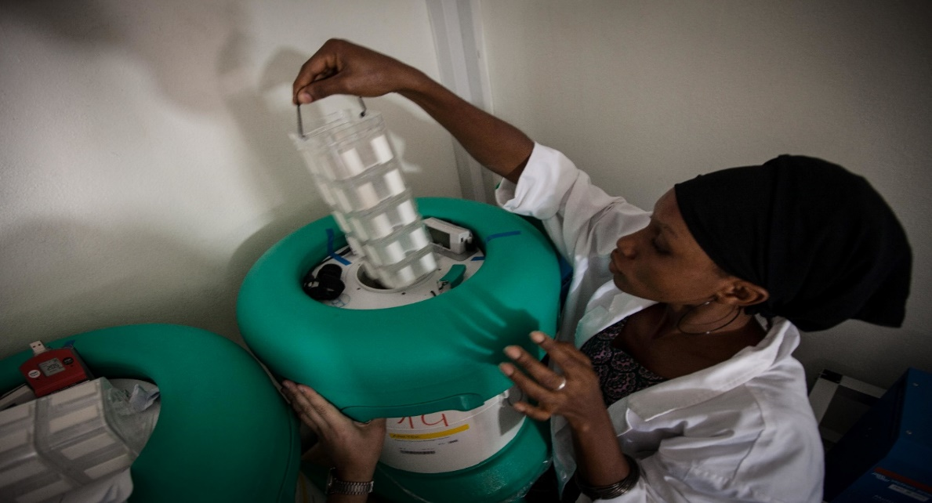
International Coordinating Group on Vaccine Provision (ICG)
ICG manages provision of emergency vaccine supplies and antibiotics/antivirals to any country during outbreaks
The ICG is made up of four member agencies:
UNICEF: United Nations Children’s Fund
WHO: World Health Organization
MSF: Médecins sans Frontières
IFRC: International Federation of the Red Cross and Red Crescent Societies
Gavi supports operational costs for eligible countries
https://www.who.int/groups/icg/about

Slide 4
Guiding principles
Equity: Distribution of vaccines based on public health priorities
Rapid and timely access: delivery of vaccines within a defined timeframe to control outbreaks
Independence: decisions are made independent of political or economic influences with the sole goal to respond to a public health emergency
https://www.who.int/groups/icg/about

Slide 5
Stockpile vaccines
Meningococcal (1997)
Yellow Fever (2001)
Cholera
(2013)
Ebola
(2021)
Currently, ERVEBO® is the only vaccine available in the Ebola vaccine stockpile and if an outbreak occurs, ERVEBO® will be deployed for reactive vaccination.

Slide 6
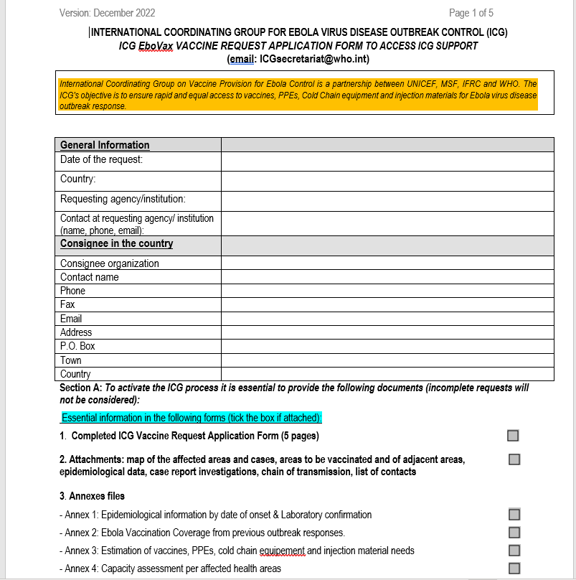
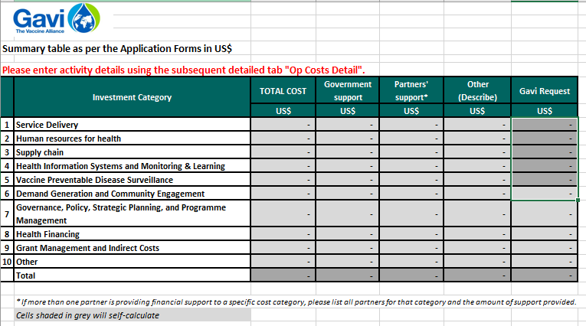
Stockpile use
Stockpiles are reserved for outbreak response
The ICG has offered doses with limited shelf life (<12 months) to Ebola at-risk countries for preventive vaccination of at-risk groups
Operational costs associated with vaccine delivery are available
https://www.who.int/groups/icg/ebola-virus-disease/ebola-stockpiles

Slide 7
Rolling stockpile – there is adequate supply
In 2018-2021 we were in a very different place
Supply constraints
Stockpile was filled over multiple years
Today we have >500,000 doses in stockpile
Few countries expressed interest in preventive vaccination since the offer went out multiple times in 2023 and 2024
Current Status of Global Ebola Vaccine Stockpile
>100,000 doses available in 2024 for preventive use

Slide 8
Process for submission
Vaccine stocks can be accessed by ANY country facing an epidemic ANYWHERE in the world, as long as the country’s request fulfills ICG’s criteria for release of vaccine stocks
Requests are evaluated using epidemiological data, vaccination strategy, vaccine availability in the emergency stockpile, pre-existing stocks in the country and operational aspects of the epidemic response
Country must complete and submit a request to the ICG Secretariat using the standard application form, with annexes and relevant documents
The ICG secretariat circulates the request to the ICG members from the four agencies
ICG members decide by consensus on the release of vaccines and other supplies to the requesting country
If approved, UNICEF Supply Division organizes the delivery of vaccines to the country

Slide 9
ICG process)
Country Request
Submission (Recommended within 7 days)
Circulation (within one day)
Decision in 48 hours
Approval
Procurement
Packing and shipment
Arrival
Request more information
ICG secretariat
IFRC, MSF, UNICEF, WHO
*ICG decisions are made by consensus
ICG
10 days
UNICEF Supply Division
Manufacturers
Vaccines in Country
IFRC: International Federation of the Red Cross and Red Crescent Societies MSF: Médecins sans Frontières UNICEF: United Nations Children’s Fund WHO: World Health Organization

Slide 10
Managing vaccine stocks
The emergency vaccine stockpiles are stored at the manufacturer's facilities until their release is decided by the ICG
UNICEF procures and ships vaccines and supplies on behalf of the ICG
ICG partners on the ground (IFRC, MSF, UNICEF, WHO) support the country on vaccine logistics and roll out of immunization campaigns
Gavi finances the ICG’s stockpiles and Gavi eligible countries can receive the vaccines free of cost, in addition to support for operational cost to implement the campaign
Non-Gavi-supported countries are responsible for reimbursing the cost of the vaccines and its transport, and for finding a source for the operational costs of the campaign

Slide 11
How to request doses
Ensure vaccine has in country regulatory approval/off label use
To access the vaccine, countries are solicited to submit a request to the ICG secretariat at icgsecretariat@who.int
Operational costs to support delivery can be requested and should be submitted with budget for the delivery cost (https://www.who.int/groups/icg/ebola-virus-disease/ebola-stockpiles)

Slide 12
Summary
ICG manage 4 stockpiles reserved for outbreak response, Ebola is one
Countries can submit applications to access vaccine stocks
Requests should be submitted as soon as possible to ensure the greatest impact on morbidity and mortality

Slide 13
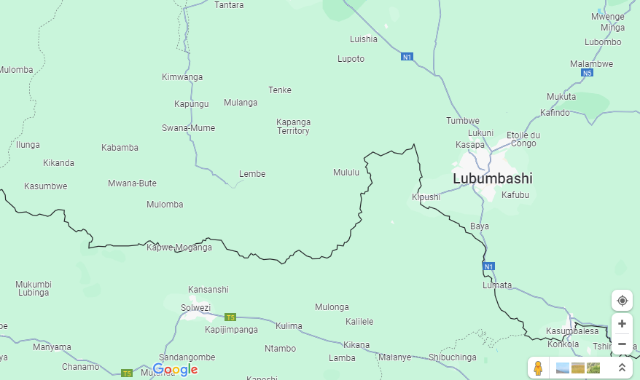
Scenario
On the 19th of June, 2024, the chief medical officer of the Mulomba in DRC near the border of Zambia, called the Minister of Health in Kinshasa to report that an exceptionally lethal disease had become epidemic. Since the first of June, 5 patients at a local hospital and 2 doctors and 1 midwife employed by the hospital had developed an illness characterized by fever, vomiting, abdominal pain, and bloody diarrhea that rapidly progressed to death. The officer reported that the illness appeared to be spreading among the remaining hospital staff.
What could this mystery disease be?
DRC
Zambia

Slide 14
Scenario
Would you submit an ICG application for Ebola vaccine doses? Why or why not?
It is lab confirmed to be Ebola virus
What is the next step? Would you submit an ICG application for Ebola vaccine doses? Why or why not?
What might Zambia consider in the immediate future?
What might Zambia consider for preparedness (medium/long-term)?

